Slide 1
Solution of System of Nonlinear Equations: Fixed Point Iteration Method (FPIM)
Lecture-2

Slide 2
Objective:
Solve the system of nonlinear equations to find roots of the system using FPIM

Slide 3
Fixed Point Iteration Method (one variable)
The algorithm and convergence criteria (CC) of FPIM on in one variable are as follows:
Algorithm and CC:
Step 1: Consider nonlinear equation in one variable,
f(x)=0 Eq.(1)
Step 2: Rewrite the given equation as follows:
Step 3: Initial guess x0, compute

Slide 4
Step 4: Use iteration formula given in Eq. (3),
Then calculate
by using initial guess value and continue
this process till hold stop criteria.
Stop criteria:

Slide 5
Example
Example 1: Comment on the results of the given equation
has a root near x=1.4.
Solution: Consider
Arrange Eq.(1) and we get three iterative functions follows as:
Choose iterative function (a), and we can write

Slide 6
Now, calculate
We have, x0=1.4, so consider n=0 and we get
[Substitute the value of x0]
The sequence will not converge because
Similarly, choose iterative function (b), and we can write
Now, calculate

Slide 7
We have, x0=1.4, so consider n=0 and we get
[Substitute the value of x0]
The sequence will converge because
Similarly, choose iterative function (c), and we can write
Now, calculate

Slide 8
We have, x0=1.4, so consider n=0 and we get
[Substitute the value of x0]
The sequence will converge because
Example 2: Given that
If the iterative formula
converge to the root near the point x0=3.5, do the iteration two times to estimate the root to 4 decimal places. Also, Write down MATLAB commands to execute the iterations five times.

Slide 9
Solution: Consider
Rewrite the given equation as follows:
Calculate

Slide 10
We have, x0=3.5, so consider n=0 and we get
[Substitute the value of x0]
The sequence will converge because
1st iteration: We have, x0=3.5, so consider n=0 then Eq. (2) become
[Substitute the value of x0]

Slide 11
2nd iteration: We have now, x1=3.501951, so consider n=1 then Eq. (2)
become
[Substitute the value of x1]
3rd iteration: We have now, x2=3.502129, so consider n=2 then Eq. (2)
become
[Substitute the value of x2]

Slide 12
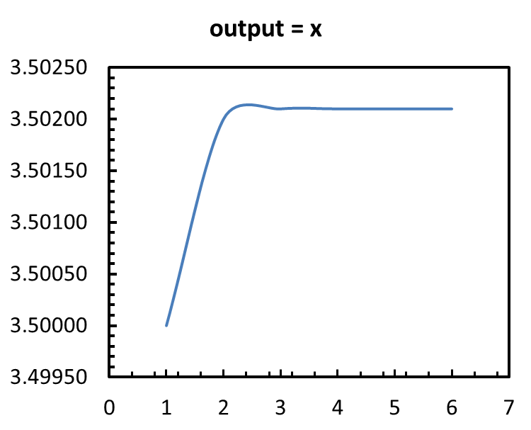
Program code in MATLAB:
Program code:
clear all
close all
clc
f=@(x)(2+3.*x+2.*cos(2.*x))./4;
x(1)=3.5;
for n=1:5
x(n+1)=f(x(n));
end
output=x'
Output:
x
3.5000
3.5020
3.5021
3.5021
3.5021
3.5021

Slide 13
FPIM for system of NLE in two variables
The Algorithm and stop criteria of iteration to find the root of nonlinear equation in two variables by applying Fixed point iteration are as follows:
Algorithm:
Step 1: Consider nonlinear equation in two variables,
Step 2: Rewrite the given equation as follows:
Step 3: If there is a point (p,q) such that,
then (p,q) is a fixed point of the system and this (p,q) is a root of the system.

Slide 14
Step 4: Arrangement Eq.(2) and assume an iteration formula such as
Then calculate
by using initial guess value and continue
this process till hold stop criteria.
Stop criteria:
1. Iterative formula will converge close to fixed point (p,q)

Slide 15
Convergence and divergence criteria:
(x0, y0) is close to the fixed point (p,q).
(i) if Eq.(4a) and Eq.(4b) holds.
Then the iterative formula given in Eq. (3) will converge to the fixed point (p,q).
(ii) If the conditions given in Eq.(4a) and Eq.(4b) are not satisfied, the iterative process might diverse. The above method can be extended for more than two variables.

Slide 16
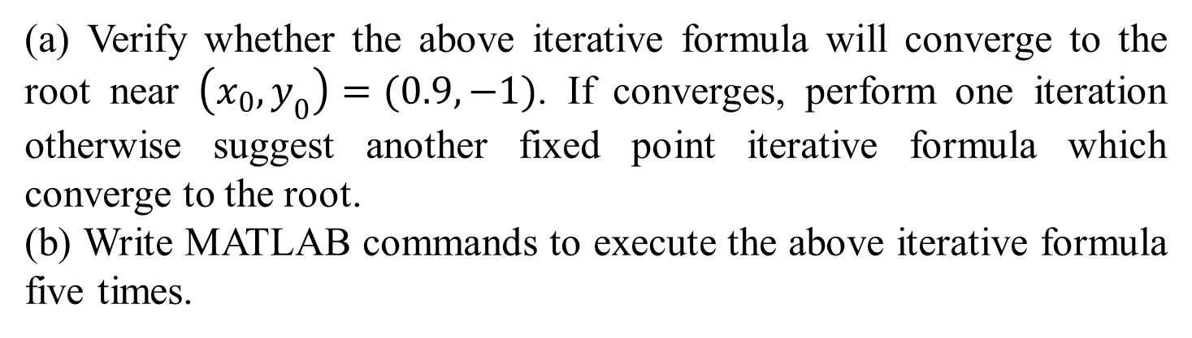
Example
Example 3: Consider the system
A fixed point iteration formula is suggested to estimate root at (x0,y0)=(0.9,1) given as follows:
(a) Verify whether the above iterative formula will converge to the root near $\left(x_{0}, y_{0}\right)=(0.9, −1)$. If converges, perform one iteration otherwise suggest another fixed point iterative formula which converge to the root.
(b) Write MATLAB commands to execute the above iterative formula five times.

Slide 17

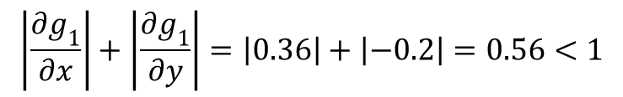
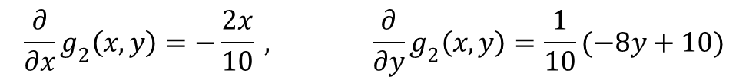
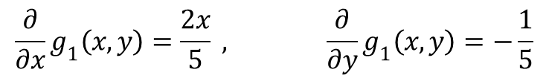
Solution: From the iterative formula, let us define
Here,
$$\frac{∂}{∂x}g_{1}\left(x,y\right)=\frac{2x}{5} , \frac{∂}{∂y}g_{1}\left(x,y\right)=−\frac{1}{5}$$
and
$$\frac{∂}{∂x}g_{2}\left(x,y\right)=−\frac{2x}{10} , \frac{∂}{∂y}g_{2}\left(x,y\right)=\frac{1}{10}(−8y+10)$$
Near point (0.9, -1.0) we have,
$$\left|\frac{∂g_{1}}{∂x}\right|+\left|\frac{∂g_{1}}{∂y}\right|=\left|0.36\right|+\left|−0.2\right|=0.56<1$$
$g_{1}(x,y)$
Satisfy convergence criteria.

Slide 18

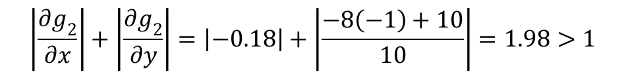
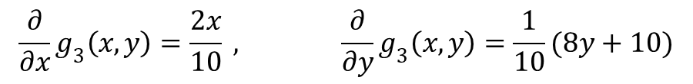
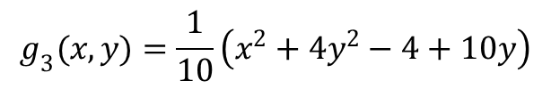
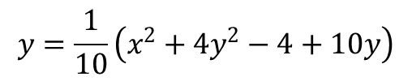
But it can be seen, that
$$\left|\frac{∂g_{2}}{∂x}\right|+\left|\frac{∂g_{2}}{∂y}\right|=\left|−0.18\right|+\left|\frac{−8\left(−1\right)+10}{10}\right|=1.98>1$$
Test fails and the convergence is not guaranteed. Rearranging the second equation by
$$x^{2}+4y^{2}−4+10y=10y$$
Now, we have
$$y=\frac{1}{10}\left(x^{2}+4y^{2}−4+10y\right)$$
So, suggested iterative formula can be
$$g_{3}(x,y)=\frac{1}{10}\left(x^{2}+4y^{2}−4+10y\right)$$
Let calculate
$$\frac{∂}{∂x}g_{3}\left(x,y\right)=\frac{2x}{10} , \frac{∂}{∂y}g_{3}\left(x,y\right)=\frac{1}{10}(8y+10)$$

Slide 19

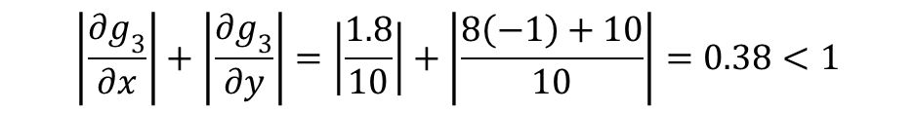
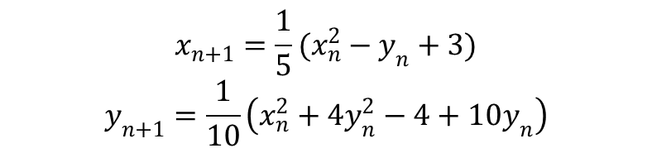
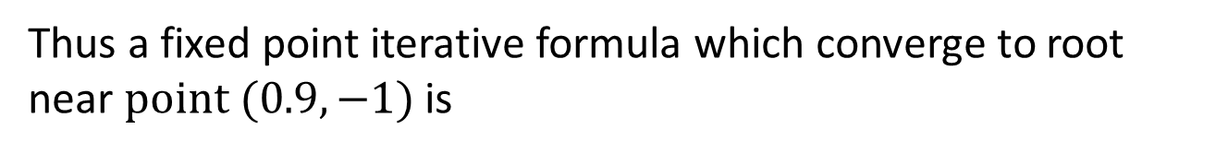
At near point (x0,y0)=(0.9,-1)
$$\left|\frac{∂g_{3}}{∂x}\right|+\left|\frac{∂g_{3}}{∂y}\right|=\left|\frac{1.8}{10}\right|+\left|\frac{8\left(−1\right)+10}{10}\right|=0.38<1$$
So,
$g_{3}(x,y)$
satisfy convergence criteria.
Thus a fixed point iterative formula which converge to root near $point (0.9, −1)$ is
$$x_{n+1}=\frac{1}{5}(x_{n}^{2}−y_{n}+3)$$
$$y_{n+1}=\frac{1}{10}\left(x_{n}^{2}+4y_{n}^{2}−4+10y_{n}\right)$$

Slide 20
Program code in MATLAB:
Program code:
clear all
close all
clc
x(1)=0.9;
y(1)=-1;
for n=1:5
x(n+1)=(x(n)^2-y(n)+3)/5;
y(n+1)=(x(n)^2+4*y(n)^2-4+10*y(n))/10;
end
Iterative_Roots = [x',y'];
Output:
Iterative_Roots :
x y
0.9000 -1.0000
0.9620 -0.9190
0.9689 -0.8886
0.9655 -0.8789
0.9622 -0.8767
0.9605 -0.8767

Slide 21
Advantages and Drawbacks: Fixed Point Iteration Method
Advantages:
Fast
Fewer calculations than bracketing methods
Requires one guess only
Easier to program
Drawbacks:
Convergence is not guaranteed

Slide 22
Outcome
System of nonlinear equations can be solved by applying Fixed Point Iteration Method (FPIM), to find roots (approximately) of the system, although it has few drawbacks.
Also, behavior of function can be predicted by analyzing roots.

Slide 23
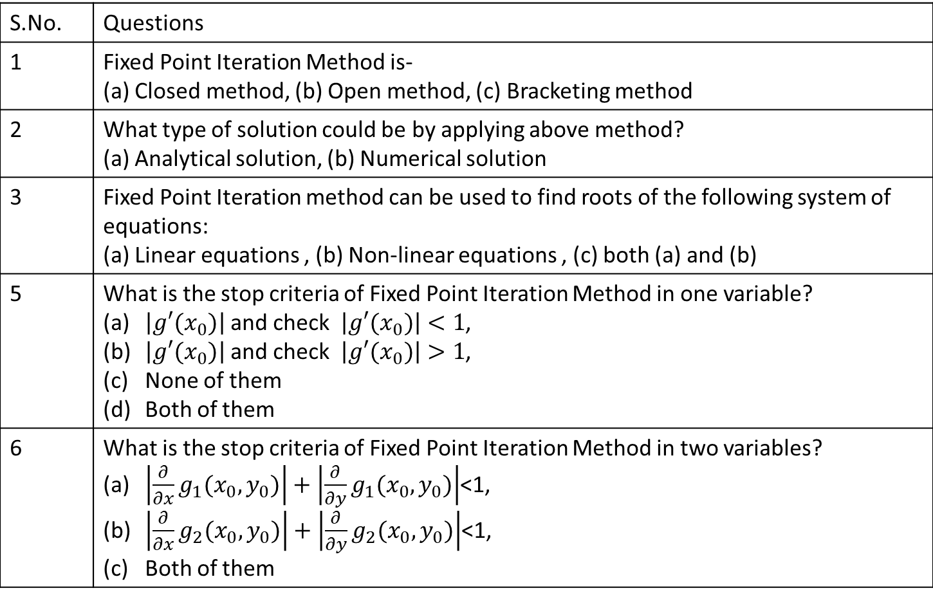
Multiple questions:
S.No. | Questions
1 | Fixed Point Iteration Method is- (a) Closed method, (b) Open method, (c) Bracketing method
2 | What type of solution could be by applying above method? (a) Analytical solution, (b) Numerical solution
3 | Fixed Point Iteration method can be used to find roots of the following system of equations: (a) Linear equations , (b) Non-linear equations , (c) both (a) and (b)
5 | What is the stop criteria of Fixed Point Iteration Method in one variable? $\left|g′(x_{0})\right|$and check $\left|g′(x_{0})\right|<1$, $\left|g′(x_{0})\right|$and check $\left|g′(x_{0})\right|>1$, None of them Both of them
6 | What is the stop criteria of Fixed Point Iteration Method in two variables? $\left|\frac{∂}{∂x}g_{1}(x_{0},y_{0})\right|+\left|\frac{∂}{∂y}g_{1}(x_{0},y_{0})\right|$<1, $\left|\frac{∂}{∂x}g_{2}(x_{0},y_{0})\right|+\left|\frac{∂}{∂y}g_{2}(x_{0},y_{0})\right|$<1, Both of them

Slide 24
S.No. | Questions
7 | How many guess value requires for applying Fixed Point Iteration Method to find roots of equations one, many, Both of them None of them
8 | What is the drawback of Fixed point iteration method? It converges, it doesn’t converges, Convergence is not guaranteed

Slide 25

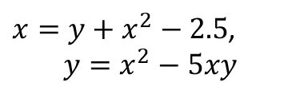
Try to do yourself
#1. The following system has a root near $\left(x_{0}, y_{0}\right)=(0.2, 0.3)$.
$$2x^{2}+y^{2}−15x+2=0,$$
$$xy^{2}+x−10y+5=0.$$
Estimate the root correct to four decimal places using fixed point iterative method.
#2. Determine the roots of the following simultaneous non linear equations
using
$x=y+x^{2}−2.5$,
$$y=x^{2}−5xy$$
Employ initial guesses of $x_{0}=y_{0}=1.0$ and discuss the results.

Slide 26
References
[1] Applied Numerical Methods With Matlab for Engineers and Scientists ( Steven C.Chapra).
[2] Applied Numerical Analysis – C.F.Gerald & P.O.Wheatley, 7th Edition, 2003, Pearson Education Limited, USA.
[3] Numerical Analysis & Computing – W. Cheney & D. Kincaid, 6th Edition, 2007, Cengage Learning, Inc, USA.
[4] Numerical Analysis – J. Douglas Faires , Annette Burden , Richard Burden, 10th Edition, 2015, Cengage Learning, Inc, USA.

